Slide 1


Data Analytics Report On FIFA Women’s World Cup Stats Presented By Team Achievers (Zainab Akinrata, Reliance Enwerem) 24/03/2022

Slide 2

Introduction
Research Goals
Identify women’s performance trends in soccer overtime
identify patterns and correlations between players’ performance and teams’ success in professional football leagues
Identify strategies utilized to influence teams’ success in global women’s football leagues
Summary of Data Analytics Steps
Data Exploration
Data Cleaning and model development using MS Excel
Data Analysis and Visualization with Tableau
Interpretation and reporting

Slide 3



Data Exploration
Data Source
The dataset is open-source and downloaded from Kaggle.
Data revolves around FIFA women’s soccer stats from 1991 to 2019.
Data Limitation
The dataset is relatively compact and “summarized”. This has effect on data modelling.
Data Cleaning & Transformation
The data was already clean.
Data was transformed using Excel and later Power BI for instant analysis.
A new column (age-group) was added to enhance analysis. This grouped the female players into ages 18-21, 22-24, 25-27, and 28-30
Certain data types such as age were changed to whole numbers (from decimals)
Blank values in “red cards” , “yellow cards” and “possession” columns were replaced with “0” (zero)

Slide 4
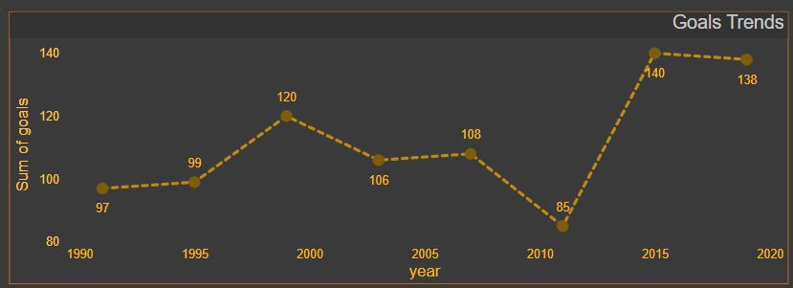
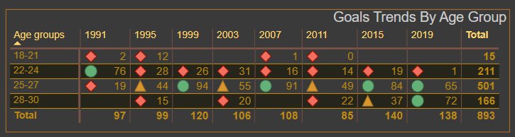
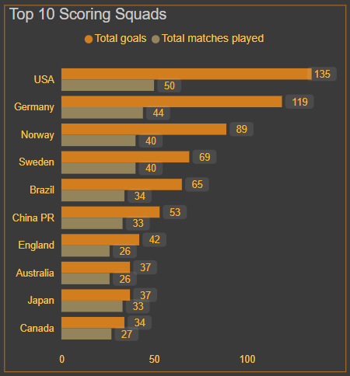
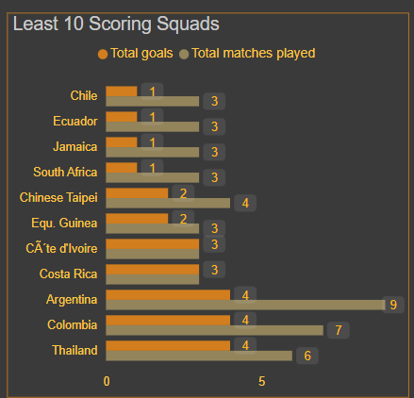
Data Analysis
The least performing age-group is 18-21. The best performing age-groups are females aged 25-27.
Perhaps, this can be attributed to the nature of the female body, and increased experience level. Females are most productive at that age.
Across 8 seasons, the number of goals scored peaked in 2015 with about 140 goals. “The worst” season was 2011 with a minimum total of 85 goals.
There is a correlation between the number of matches played and total goals scored.
Teams that get into more games tend to have higher number of goals.

Slide 5
Conclusion & Recommendation
A major strategy utilized in professional football leagues is skewed age distribution. Further analysis could reveal similarities in birthdates among top-performing players.
Apparently, Coaches have leveraged this. Hence, we observe the absence of players aged 18-21 18-21 from 2011.
More emphasis should be placed on improving the efficiency of female footballers between the ages of 18-24. This improves the chances of global teams and in turn, influences teams’ performance when this cohort moves into their mid-20s (> 25 years).

